Slide 1
Inheritance and Polymorphism

Slide 2
Inheritance
Allows us to define a new class
Called the subclass, child class, or derived class
A modified version of an existing class
Subclass inherits properties and methods of the superclass
Adding some of its own properties and methods
Overriding some of the superclass' methods

Slide 3
Inheritance (cont’d.)
In the real world, many objects are a specialized version of more general objects
Example: grasshoppers and bees are specialized types of insect
In addition to the general insect characteristics, they have unique characteristics:
Grasshoppers can jump
Bees can sting, make honey, and build hives

Slide 4
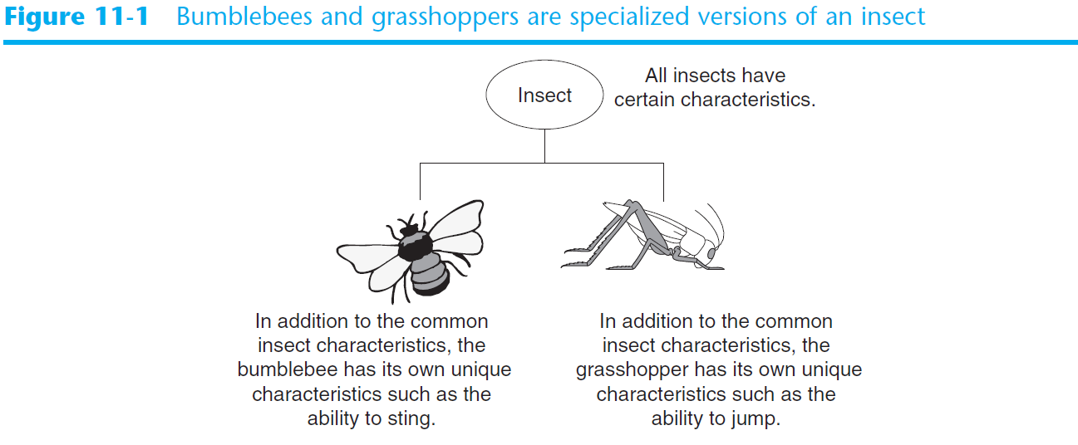
Inheritance (cont’d.)

Slide 5
Inheritance and the “Is a” Relationship
“Is a” relationship: exists when one object is a specialized version of another object
Specialized object has all the characteristics of the general object plus unique characteristics
Example: Rectangle is a shape
Daisy is a flower

Slide 6
Inheritance and the “Is a” Relationship (cont’d.)
Inheritance: used to create an “is a” relationship between classes
Superclass (base class): a general class
Subclass (derived class): a specialized class
An extended version of the superclass
Inherits attributes and methods of the superclass
New attributes and methods can be added

Slide 7
Inheritance and the “Is a” Relationship (cont’d.)
In a class definition for a subclass:
To indicate inheritance, the superclass name is placed in parentheses after subclass name
Example: class Rectangle(Shape):
The initializer method of a subclass calls the initializer method of the superclass and then initializes the unique data attributes
Add method definitions for unique methods

